Slide 1
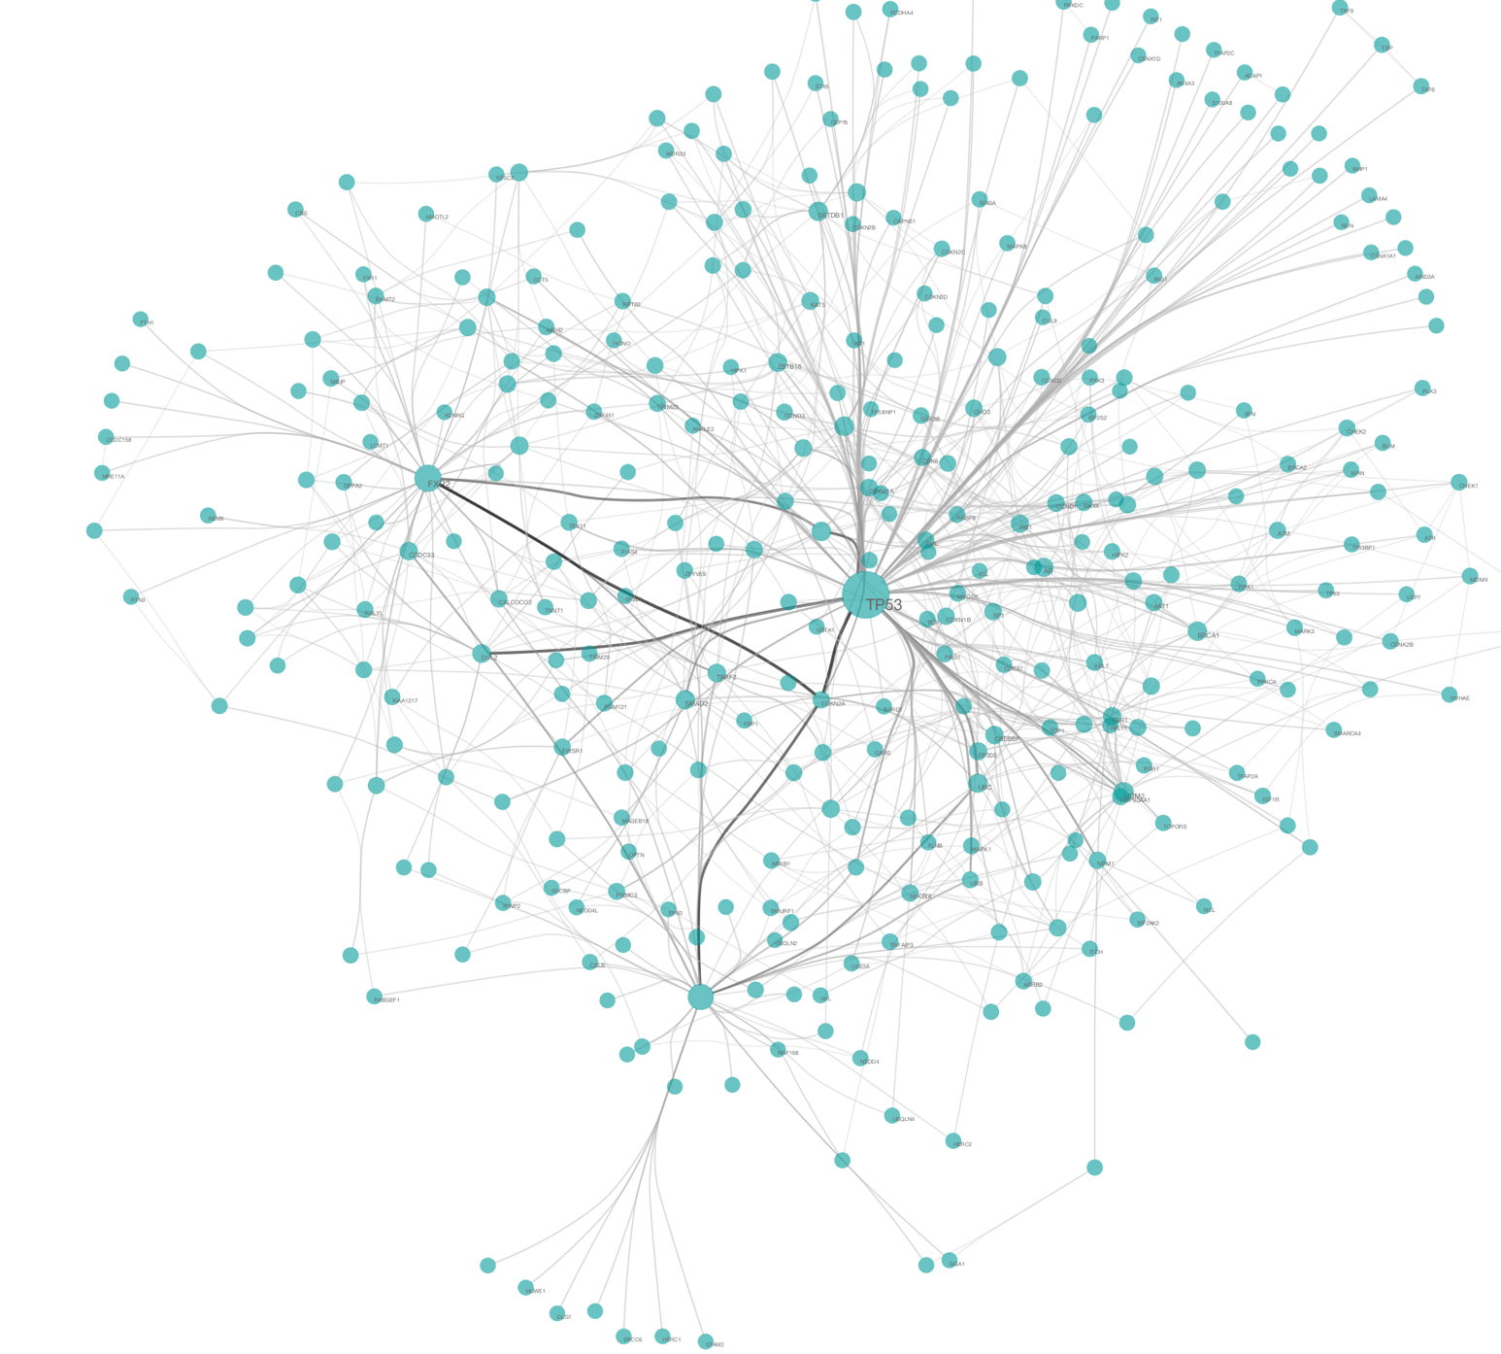
Biological Network Analysis
Hannah Carter
UCSD Department of Medicine
02/18/2020
hkcarter@ucsd.edu

Slide 2
Network Module Goals
Learn how networks can be created from high-throughput data
Understand how networks can be used to represent, analyze and interpret biological systems including:
Examples of biological networks
Common network statistics used for biological inference
How to generate a random distribution over a network
How networks have helped us understand the organization of biological systems and the implications of this organization for disease
Provide a basic computational toolkit for network visualization and analysis
Provide some examples of common algorithms for network construction and analysis
Describe sources of publicly available network data

Slide 3
Overview
Day 1: Introduction to networks
Why networks?
Network basics & examples of biological networks
What networks can teach us about biological systems
Challenges for biological network analysis
Introduction to Cytoscape and Ndex
Loading and visualizing networks
Day 2: Network analysis
Statistical hypothesis testing with networks
Motif detection
RNA seq data analysis

Slide 4
Please ask questions!

Slide 5
Why Networks?

Slide 6
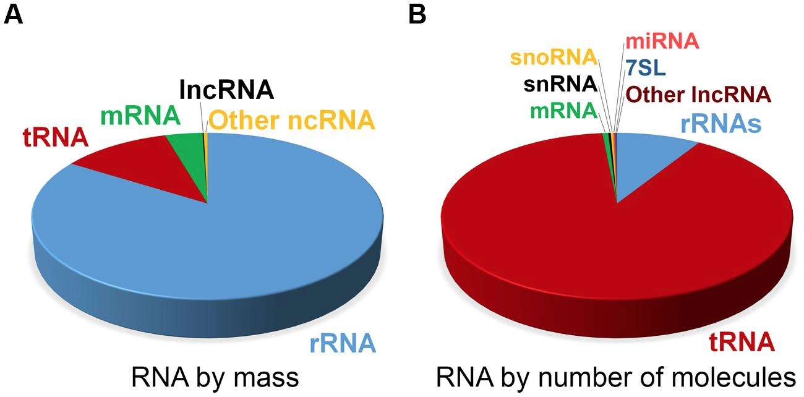
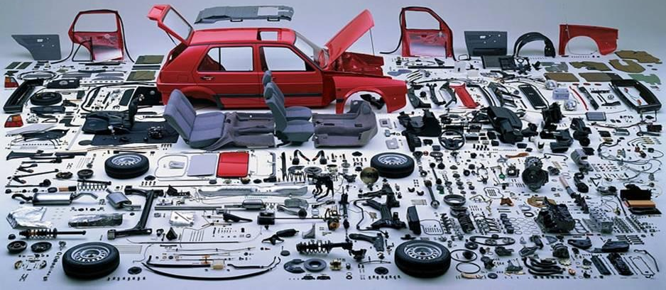
Biological Systems are Complex
Category | Homo Sapiens
Base pairs | ~ 6 billion
Chromosomes | 46
Protein coding genes | ~21,000
Proteins (including known splice isoforms) | ~92,179
Verified protein Interactions * | >240,000
Estimate of expected protein interactions ** | 650,000
Estimated proteomic diversity with SNPs and PTMs*** | 0.62 to 6.13 million
Non-coding RNAs | ??
****
Notes:
* Jones, Richard B., et al. "A quantitative protein interaction network for the ErbB receptors using protein microarrays." Nature 439.7073 (2006): 168.
** Stumpf, Michael PH, et al. "Estimating the size of the human interactome." Proceedings of the National Academy of Sciences 105.19 (2008): 6959-6964.
*** Ponomarenko, Elena A., et al. "The size of the human proteome: the width and depth." International journal of analytical chemistry 2016 (2016).
**** Palazzo, Alexander F., and Eliza S. Lee. "Non-coding RNA: what is functional and what is junk?." Frontiers in genetics 6 (2015): 2.

Slide 7
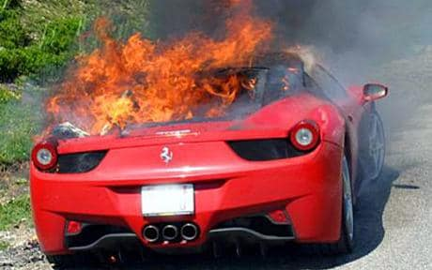
Complex systems fail in complex ways
Phenotype
Ferrari recall after 5 cars crash and spontaneously catch fire in 2010
Genotype
“Ferrari today said a flaw in the wheel arch on the rear of the £170,000 supercar is fitted with a special glue which is prone to melting. The fault brings the lining of the wheel-arch into contact with the hot exhaust pipe causing both the lining and the adhesive to heat up and ignite. As result of the fire the superheated aluminium body will subsequently melt.“
Mechanism
Notes:
http://www.dailymail.co.uk/news/article-1308061/Ferrari-recalls-cursed-supercar-FIVE-458-Italias-burst-flames.html

Slide 8
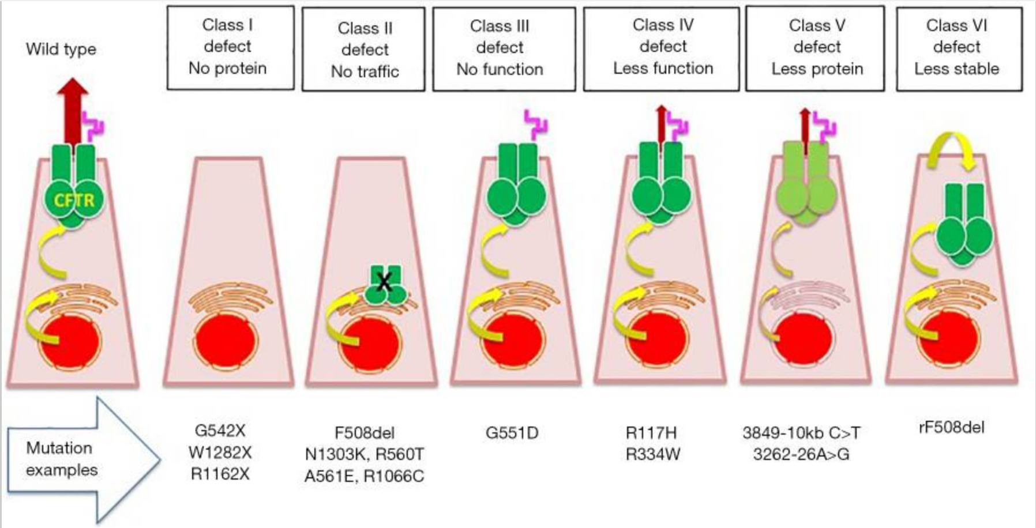
Complex systems fail in complex ways
Example: Cystic fibrosis
Defects in CFTR prevent Cl+ secretion into lung. Without Cl+, Na- is not attracted to the lung and airway surface is not adequately hydrated.

Slide 9
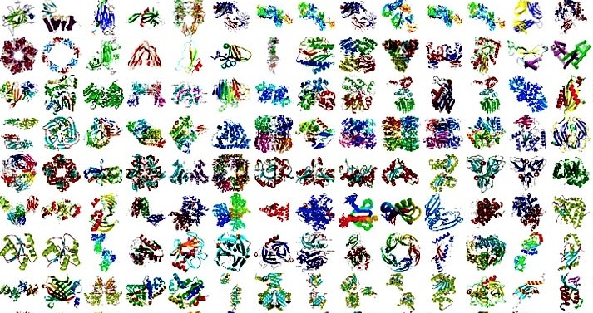
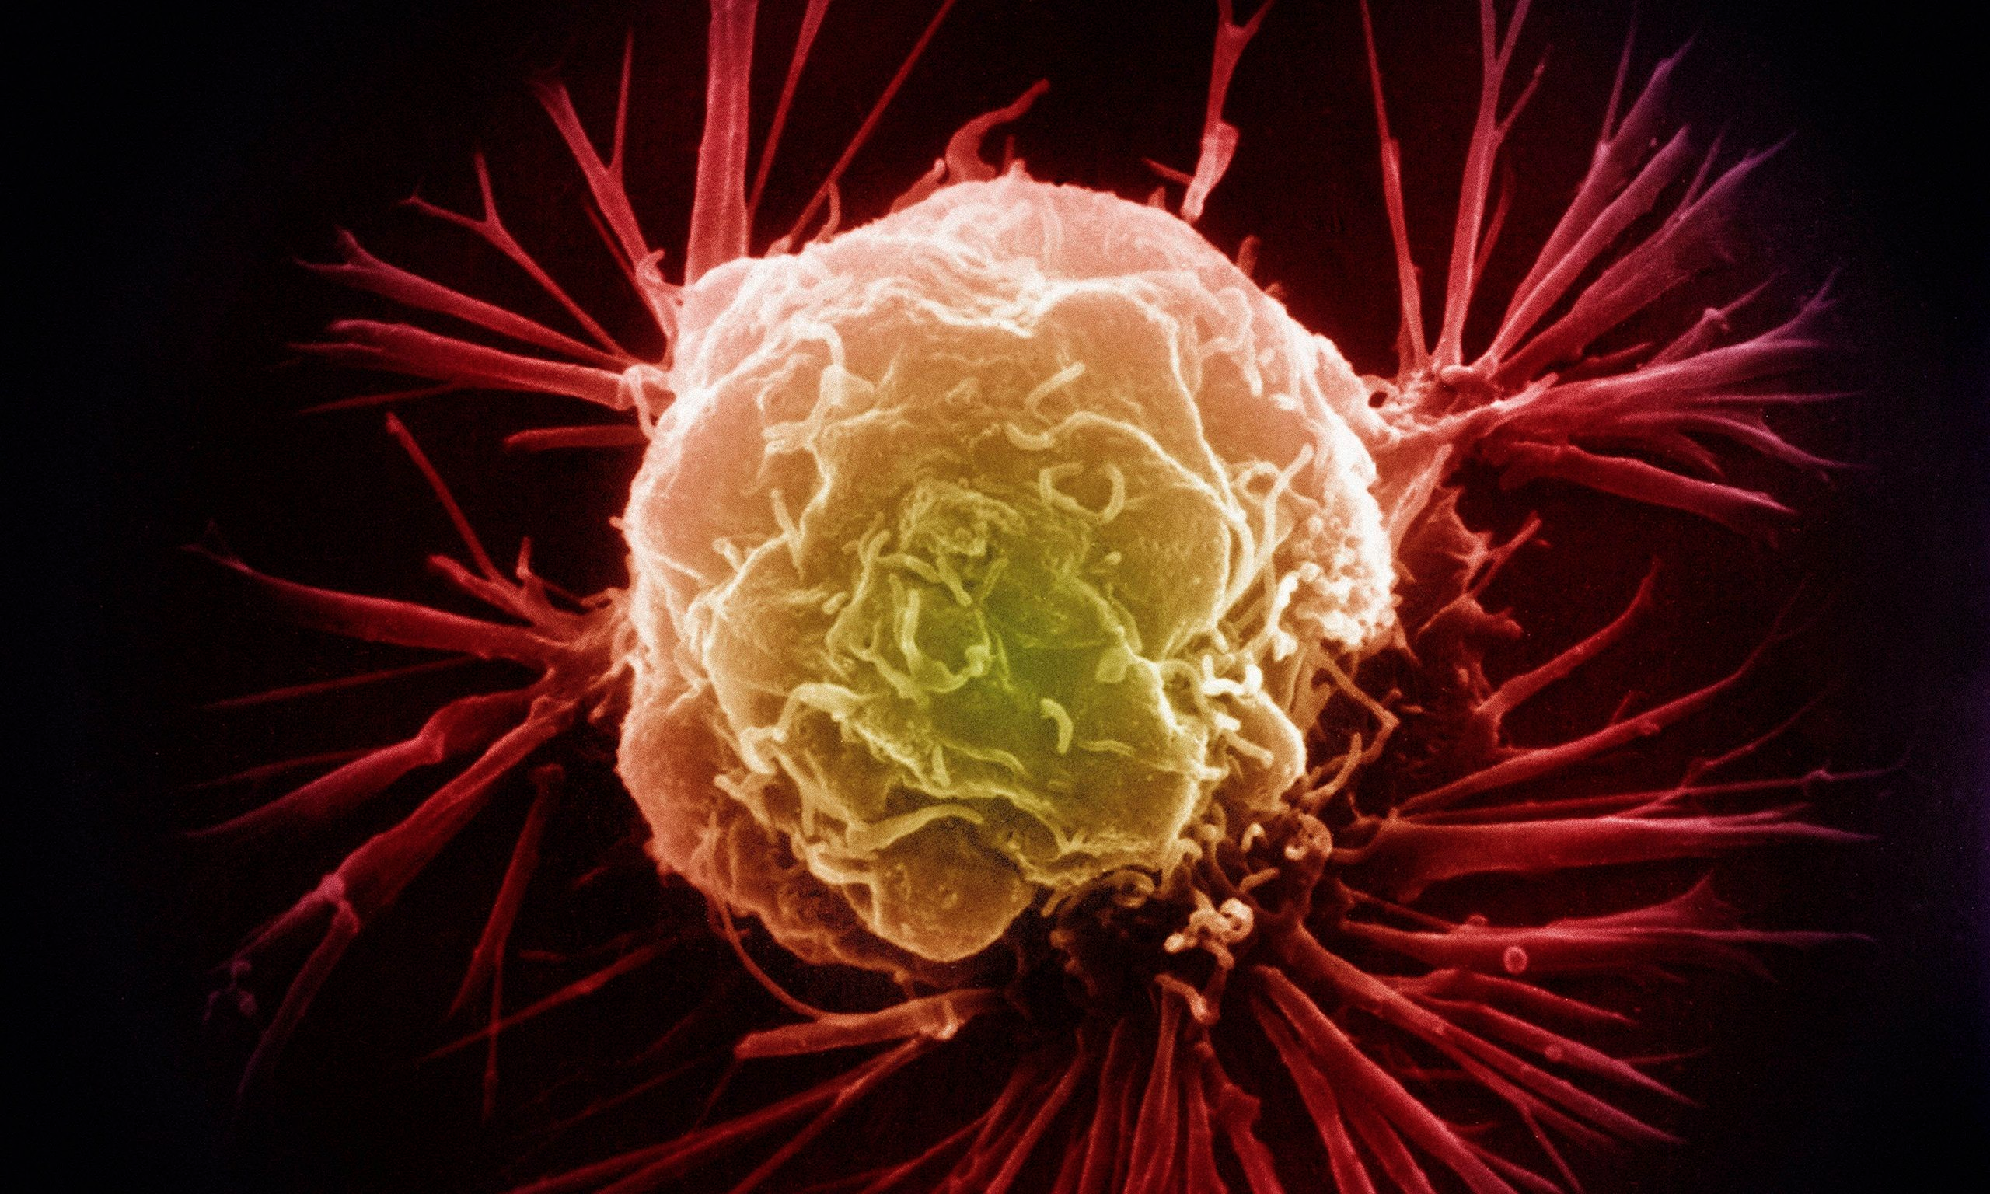

Why Networks?
Reductionist Biology
- Parts list
- Study each part individually
Systems biology
- Study behavior of the system
- Behavior arises from interactions among components
Networks as a tool for systems biology
- Explicitly model interactions
- Can be used to study complex behaviors of systems
- Are convenient tools for analyzing relationships in data generated from high throughput technologies
Notes:
The study of the interactions between the components of biological systems, and how these interactions give rise to the function and behavior of that system

Slide 10
Network Theory
Study of graphs as a representation of the relationships between discrete objects
Objects represented as nodes
Genes, proteins, enzymes, metabolites, drugs, diseases, …
Relationships represented as edges
Protein-protein interactions, enzyme-substrate pairs, co-expressed mRNAs, …

Slide 11
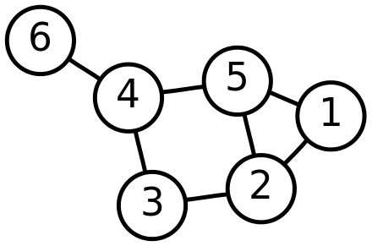
Networks are modeled by Graphs
G=(V,E)
V = vertices (or nodes)
E = edges (or links)
Subgraph – connected subset of G
G’ = (V’,E’)
V = {1, 2, 3, 4, 5, 6}
E = {{1, 2}, {1, 5}, {2, 3}, {2, 5}, {3, 4}, {4, 5 }, {4, 6}}

Slide 12
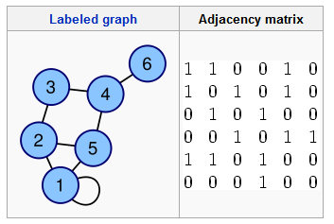
Creating Graphs from Data
Adjacency matrix
Can include edge weights in adjacency matrix
SIF format
1 1
1 2
1 5
2 3
2 5
3 4
4 5
4 6

Slide 13
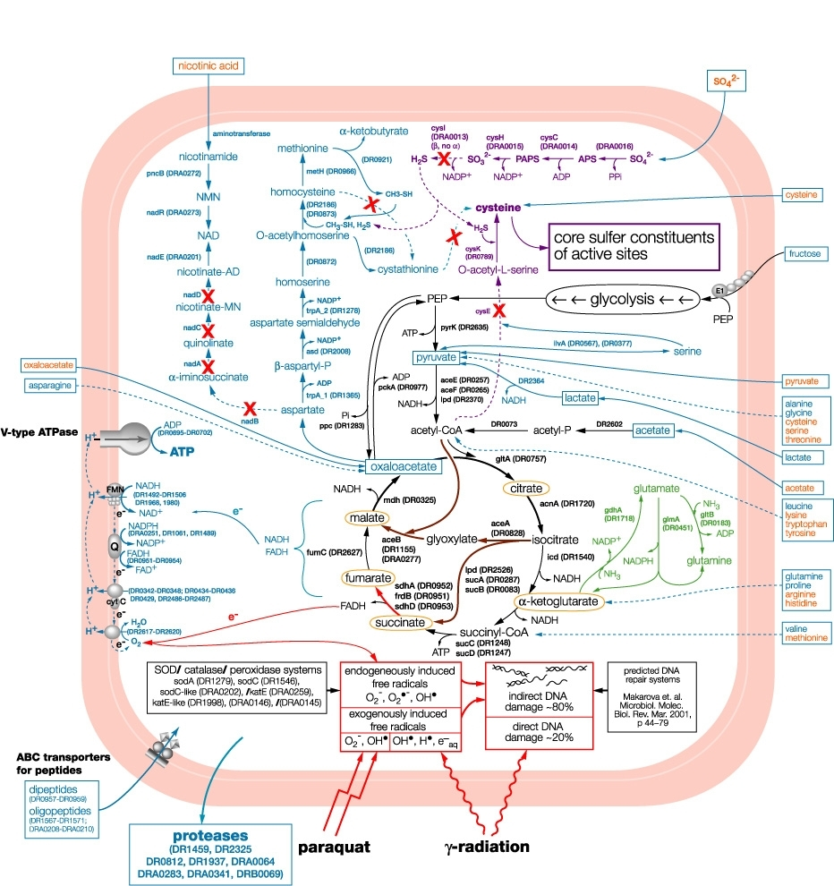
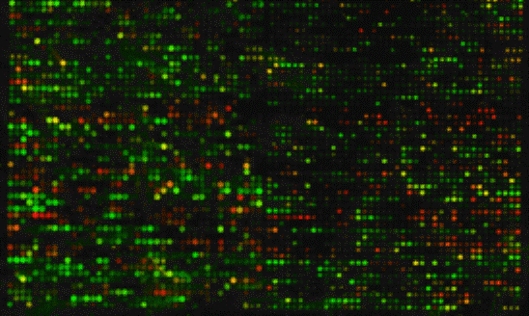
Creating Graphs from Data
Graphs that represent the known structure of biological systems
PPI networks
Gene regulatory networks from TF binding motifs
Metabolic networks
Graphs that are inferred from measured relationships between biological variables
Gene co-expression networks
Co-morbidity maps

Slide 14
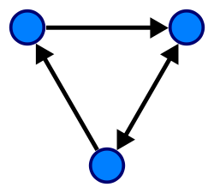
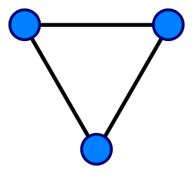
Versatility: Graphs can encode different types of information
Nodes can represent one type of entity or more
Bipartite graph
Edges can be directed or undirected (or mixed)
Directed when the direction of action or information flow is known
Different types of relationship
Example:
Enzymes and substrates
Examples:
Transcription factors and targets Protein-protein interactions

Slide 15
Could you encode a directed network with an adjacency matrix?
Could you encode a bi-partite network with an adjacency matrix?
 | A | B | C
1 | 1 | 0 | 1
2 | 1 | 1 | 0
3 | 0 | 0 | 1
1
A
2
B
3
C

Slide 16
Exercise: Creating simple graphs with R iGraph
Jupyter Notebook: Exercise 1

Slide 17
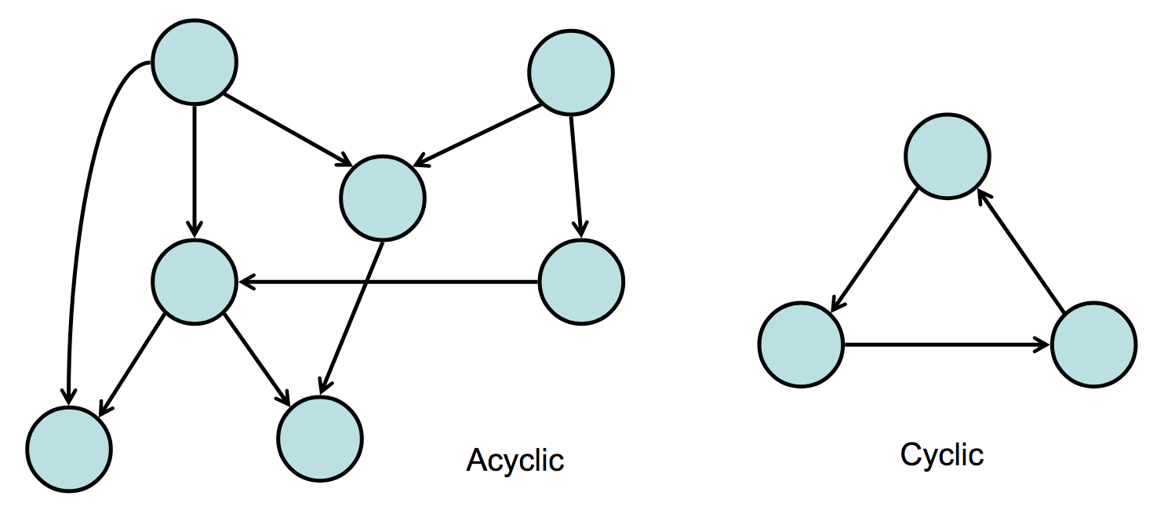
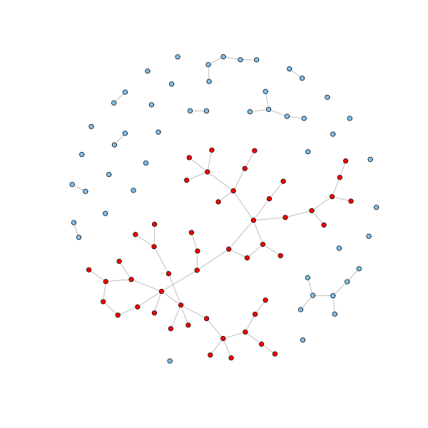
At first glance
Cyclic vs acyclic
DAG stands for Directed Acyclic Graph
Trees are undirected graphs with no cycles
Nodes can sometimes have self loops
Connected components
Set of connected nodes
Can have multiple connected components
Giant component – a component that includes the majority of nodes in the graph
Properties of the graph may have implications for various graph algorithms

Slide 18
Examples of Biological Networks
Protein-protein interaction
Metabolic
Gene Co-expression
Gene Regulatory
Genetic Interaction
Difference Networks
Abstract

Slide 19
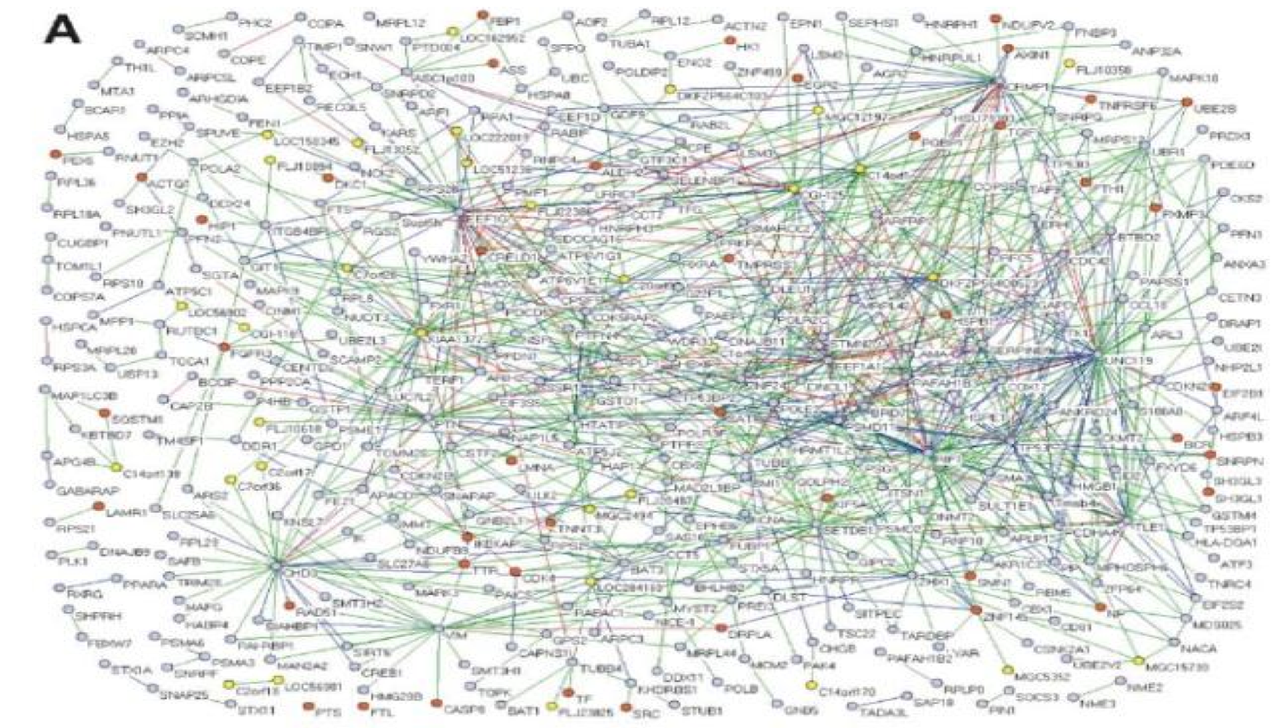
Protein Protein Interaction Network
Generated from Y2H data
MacArthur et al., PLoS ONE 3: e3086 (2008)

Slide 20
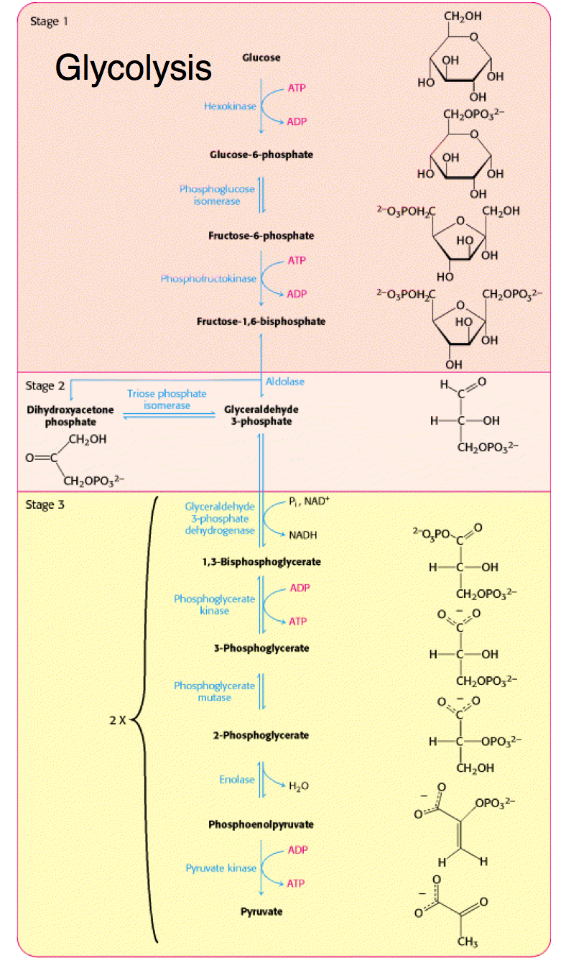
Metabolic Networks
Substrate
Reaction
Substrate
Reaction
Substrate

Slide 21
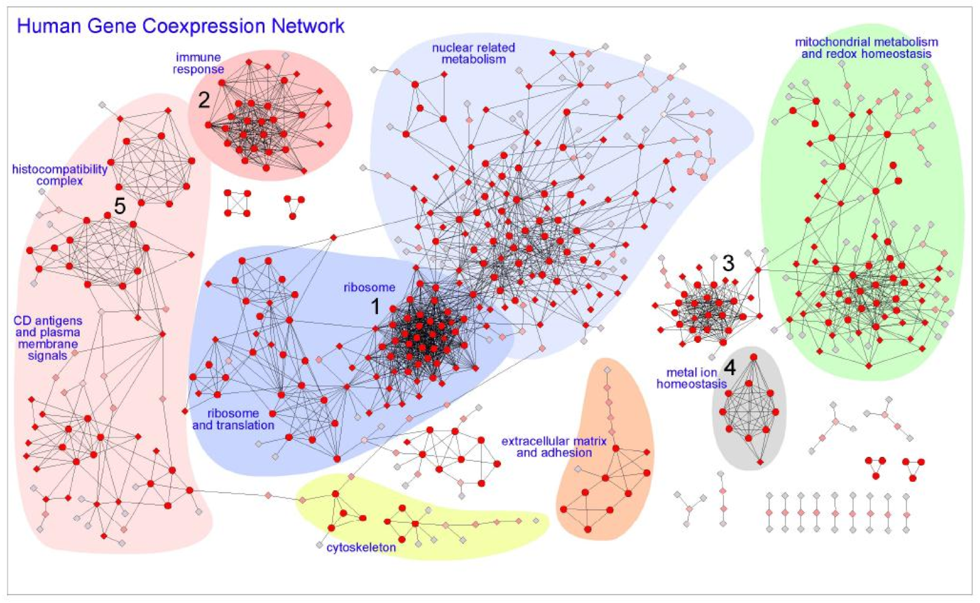
Hi-Fi Human Co-expression Network
Generated from microarrays on a panel of healthy normal tissues 3327 gene-nodes and 15841 coexpression-links
PLoS One. 2008

Slide 22
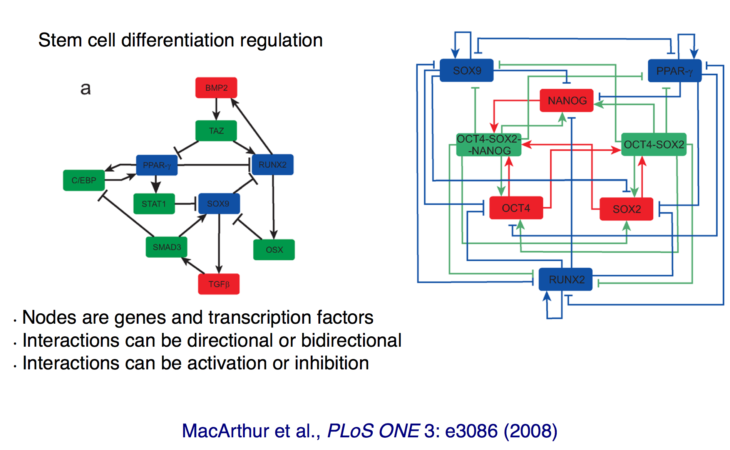
Gene Regulatory Network

Slide 23
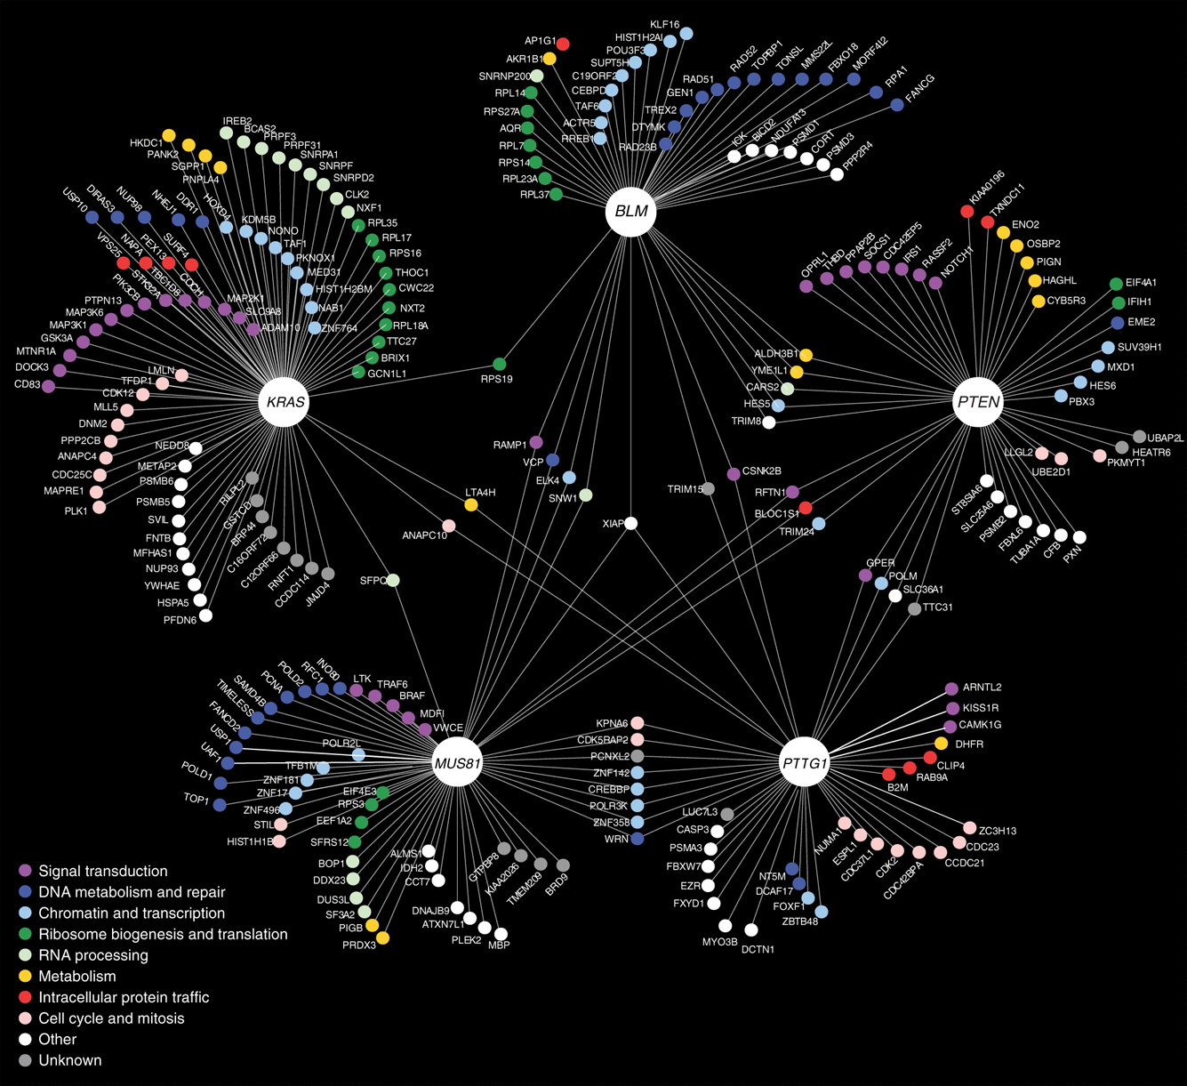
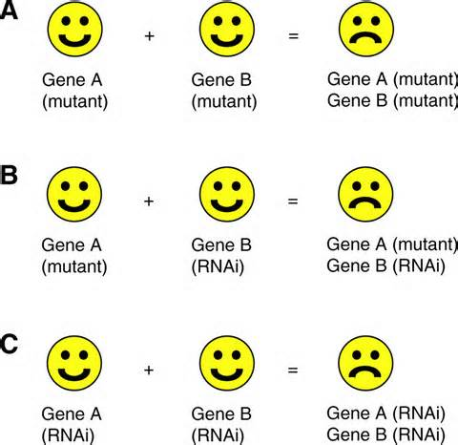
Genetic Interaction Network
Vizeacoumar et al Molecular Systems Biology (2013)
Application: Identify possible synthetic lethal interactions
Notes:
RNAi = RNA interference

Slide 24
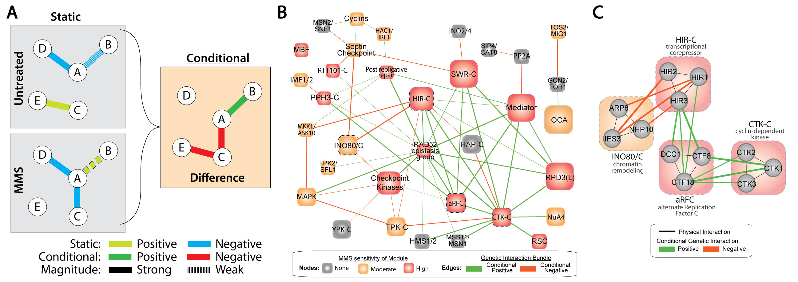
Difference Networks
Edges represent changes between different experimental conditions
Application: Compare how two distant species respond to a common stimulus

Slide 25
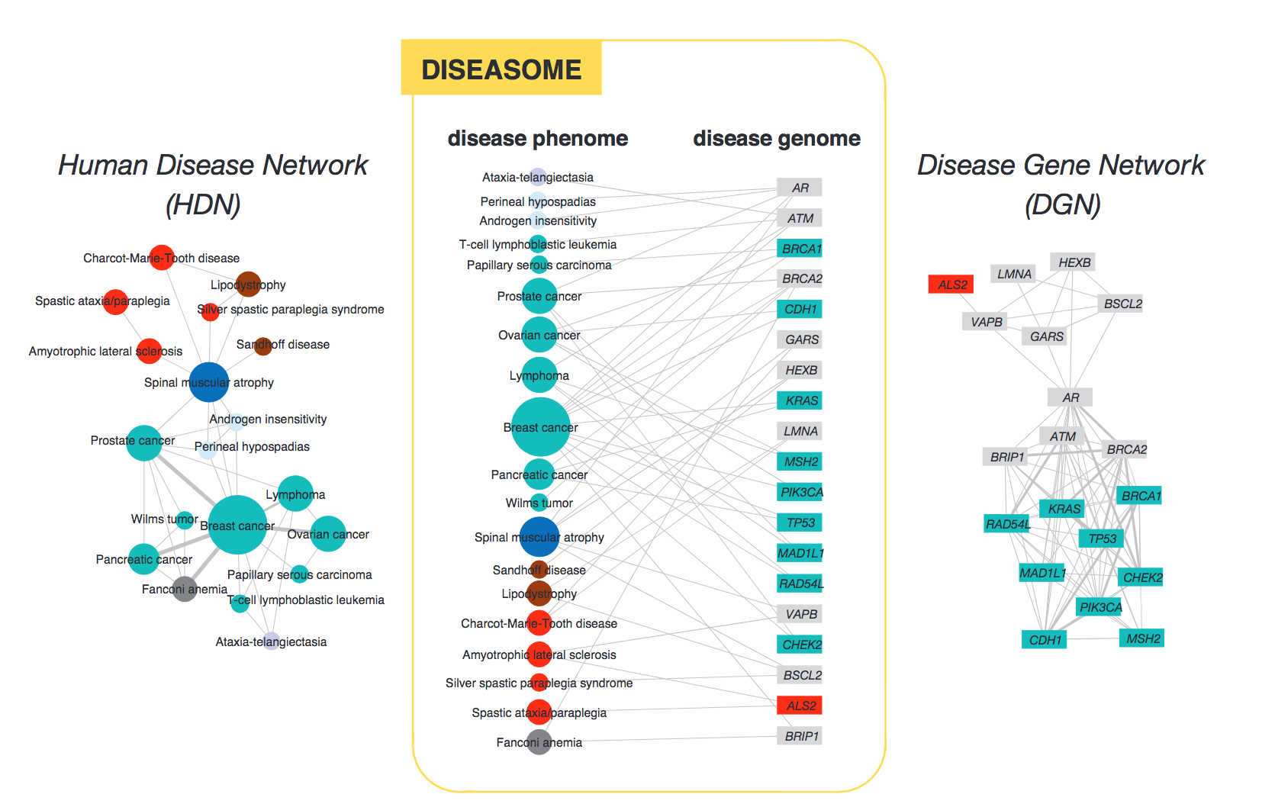
Diseaseome
Notes:
This is a collapsed view – diseases are linked by an edge if they share a gene. Node size corresponds to number of disease-associated genes

Slide 26
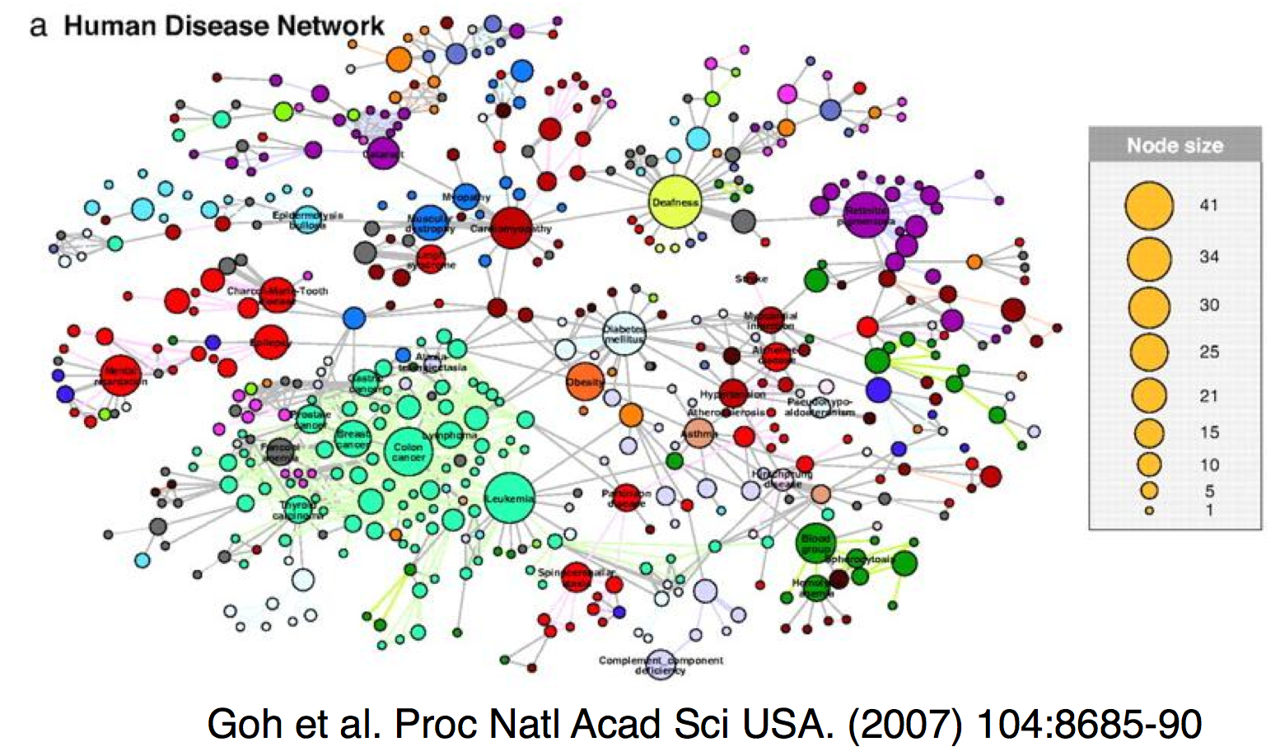
Diseaseome
Notes:
This is a collapsed view – diseases are linked by an edge if they share a gene. Node size corresponds to number of disease-associated genes

Slide 27
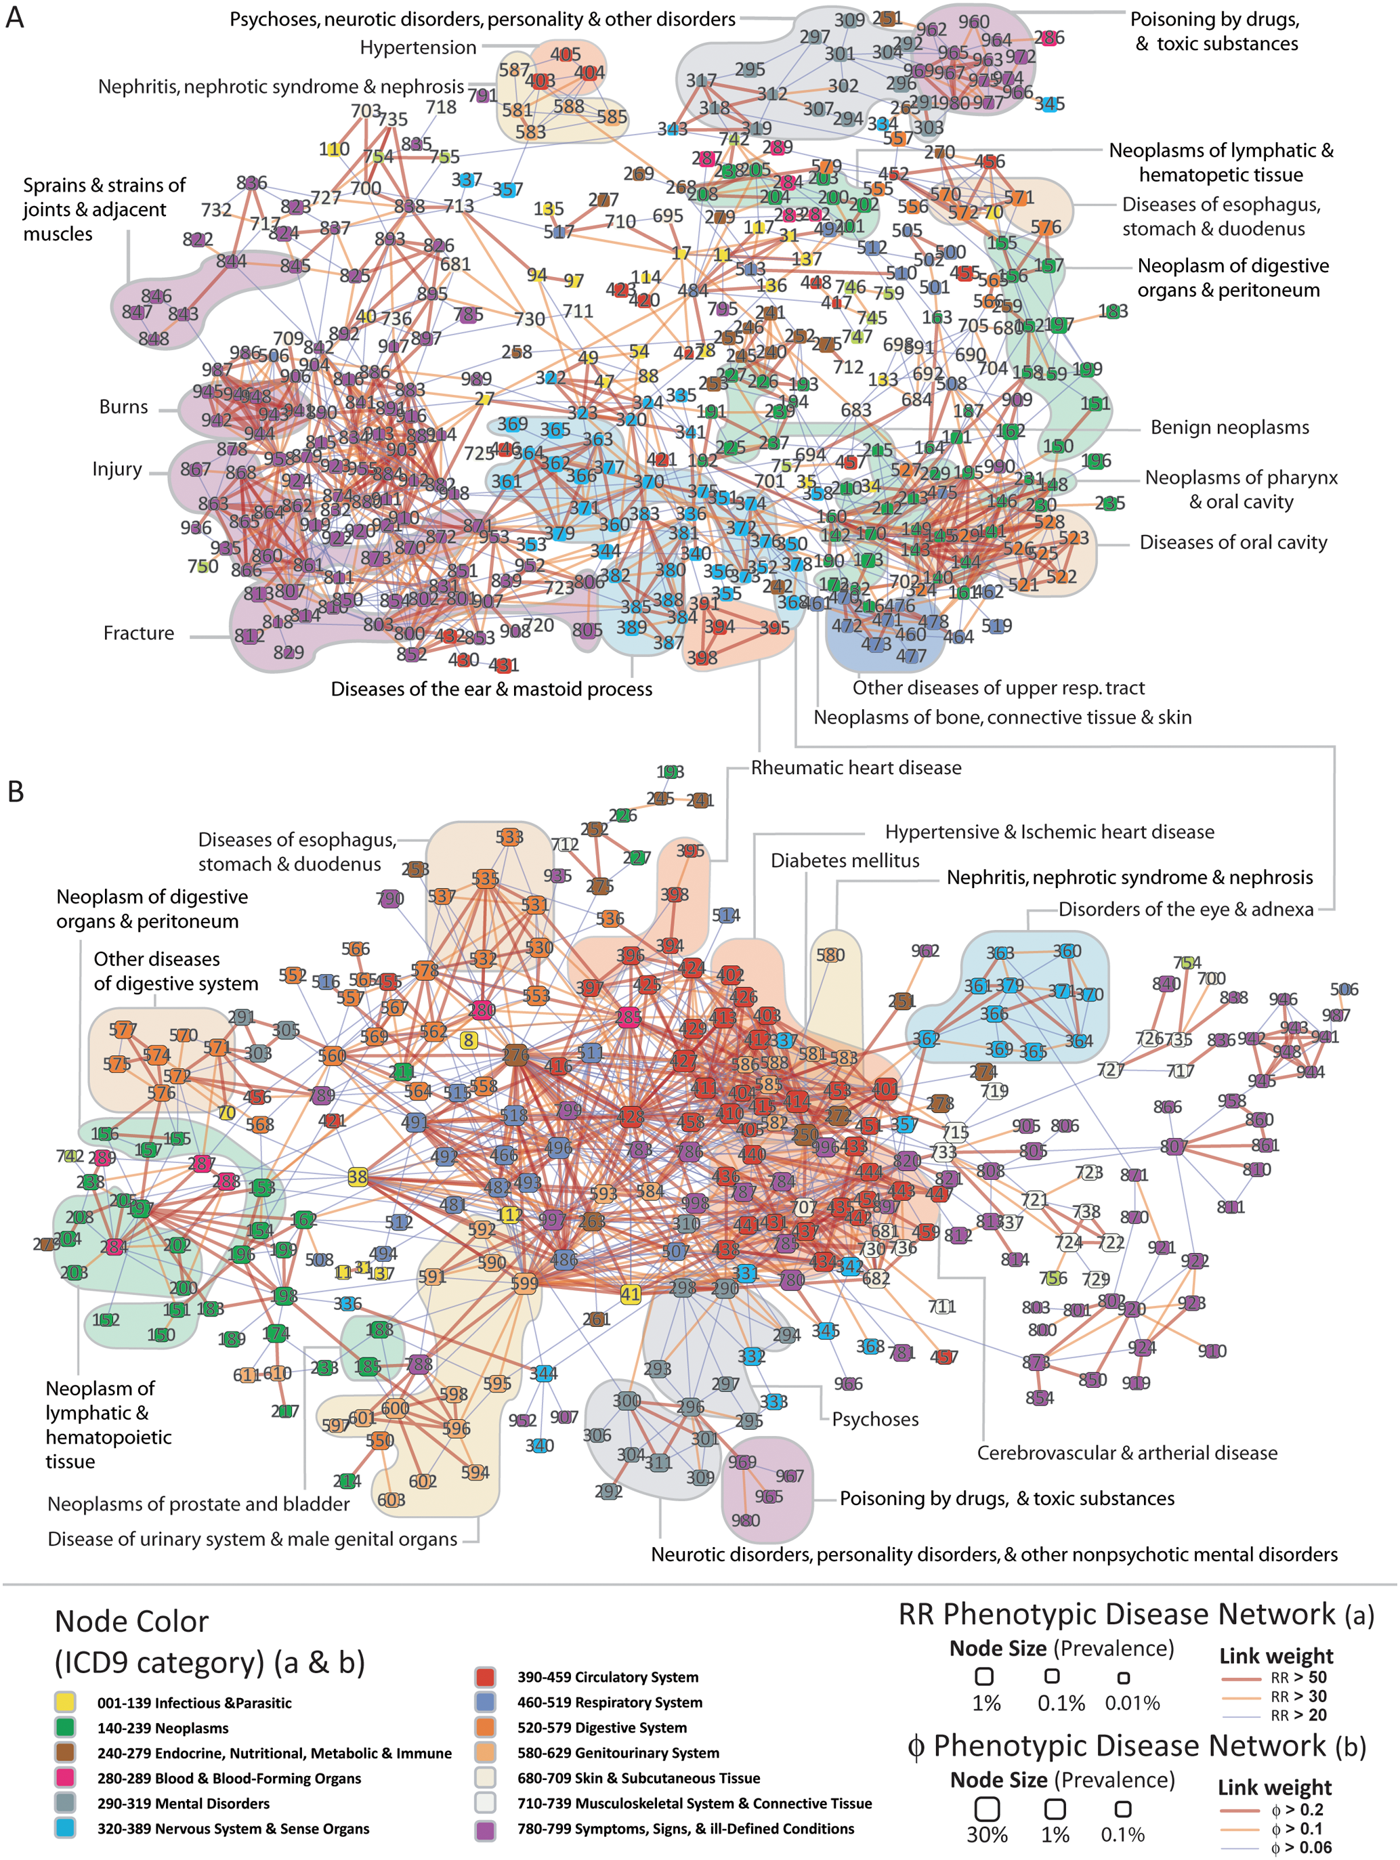
Phenotypic Disease Networks (PDNs).
Correlations obtained from the disease history of more than 30 million patients
patients develop diseases close in the network to those they already have
the progression of disease is different for patients of different genders and ethnicities;
patients diagnosed with more highly connected diseases tend to die sooner
Hidalgo et al. PLoS Comp Bio 2009

Slide 28
What can molecular networks tell us about biological systems?
Network topologies encode information about:
evolutionary constraints
function
biological information processing
vulnerabilities

Slide 29
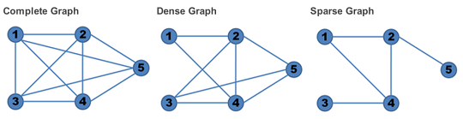
Real Networks are Sparse
A network with all possible edges between nodes (not considering self loops) is called ‘complete’

Slide 30
Characteristics of biological networks
Scale-free
– degree distribution follows a power law
Small-world
most nodes can be reached from all other nodes by traversing a small number of edges

Slide 31
Relevant graph variables “Scale Free” property
Degree
The number of edges incident on a node
In a directed graph can be divided into in-degree and out-degree
High degree nodes called ‘hubs’

Slide 32
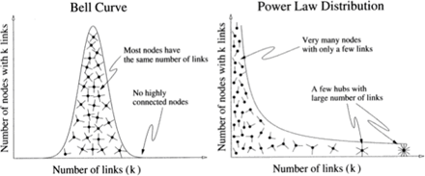
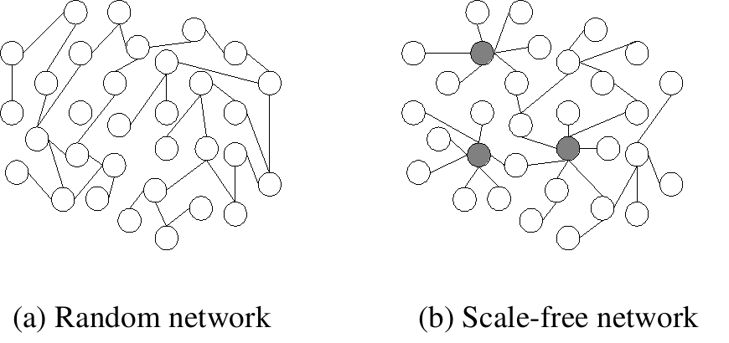
Scale Free Networks
Implications for error tolerance:
P(deg=k) - k more likely to be higher in random network
More tolerant to random failures
“Attacks” targeting higher degree nodes more likely to be disruptive to function

Slide 33
Hubs are common in biological networks
PPI networks, regulatory networks and many other biological networks have hubs (Nodes of high degree)
PPI network hubs are older¹ and more essential² than random proteins in the network
1 Fraser et al, Science (2002)
2 Jeong et al, Nature (2001)

Slide 34
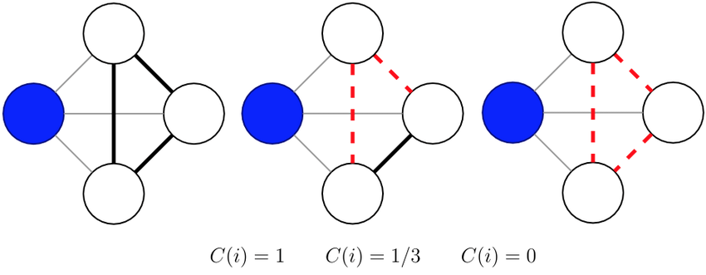
Relevant graph variables: “Small World” Property
Path
A walk in which no vertex occurs more than once
Shortest path
Diameter
Longest shortest path
Clustering Coefficient
A measure of how densely connected a graph is
Can calculate node-wise or graph-wise CC

Slide 35
Clustering Coefficient
How connected are my neighbors?
Count triangles
Denominator enumerates the possible ways a node can connect to two of its neighbors

Slide 36
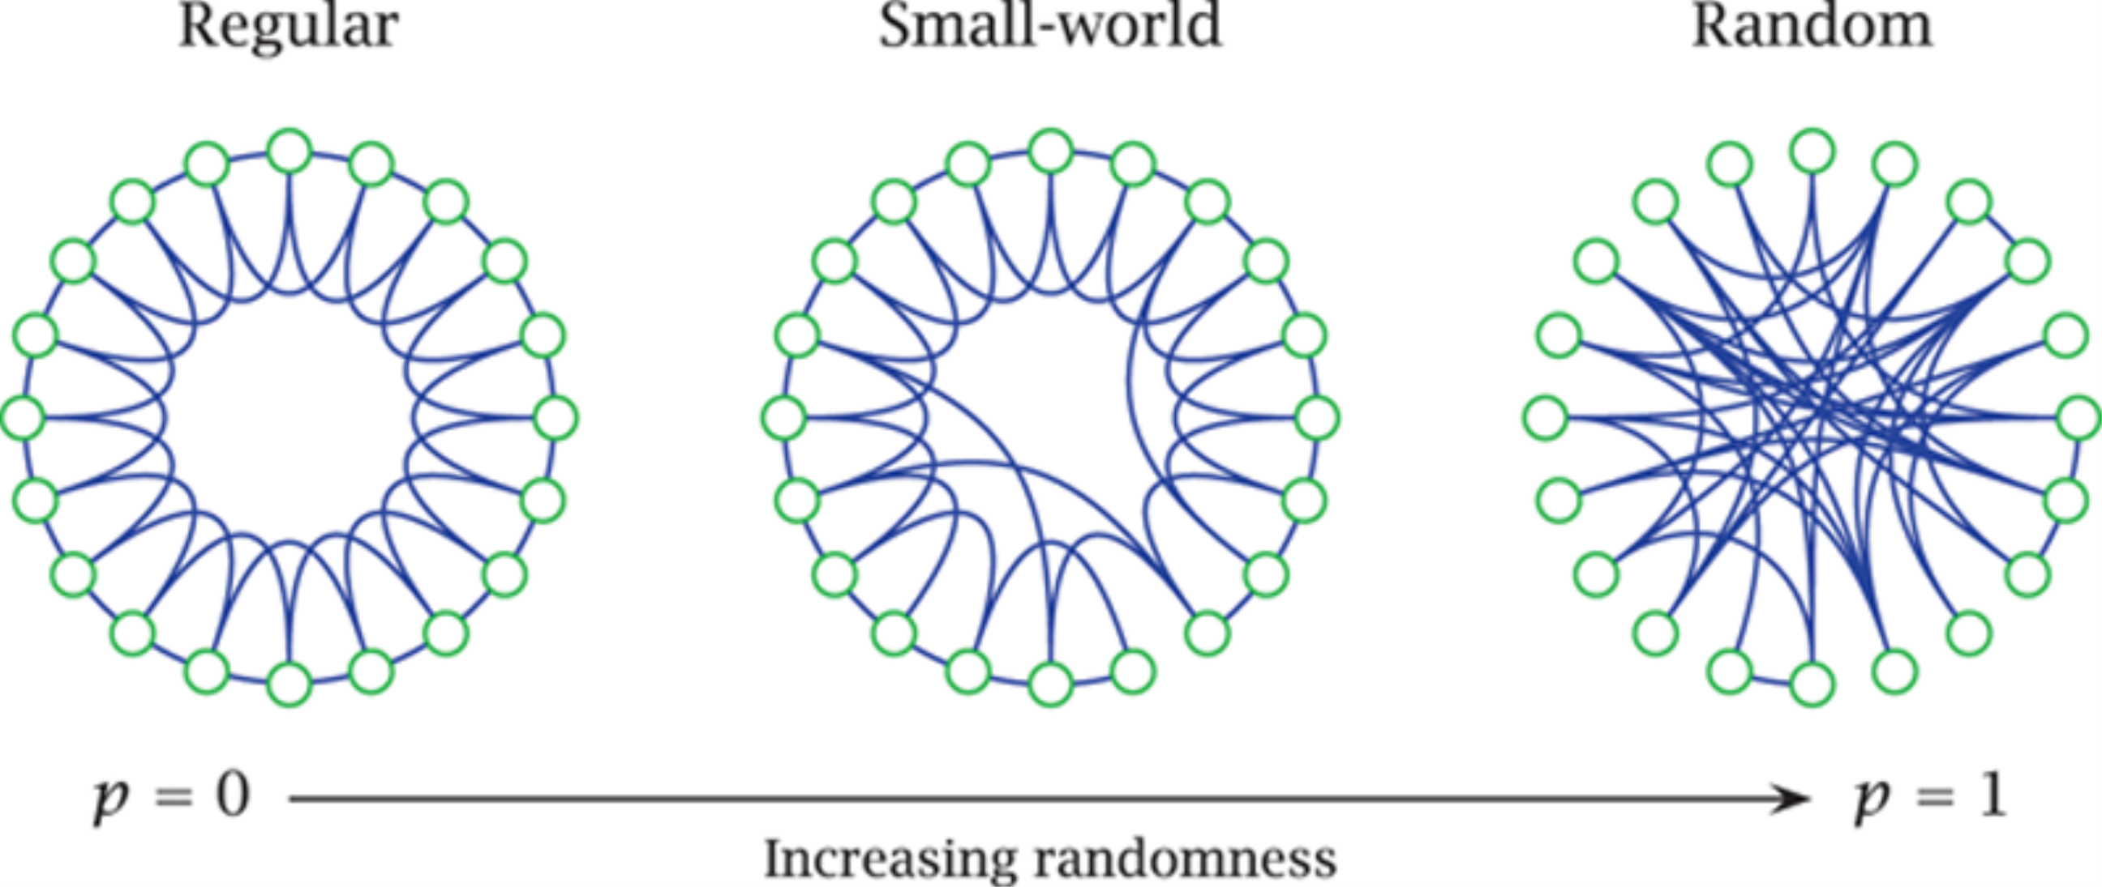
Small-world Networks
Watts & Strogatz networks (Nature 1998) illustrate the concept
A compromise between modularity and average distance to other network nodes
Higher clustering coefficient
Higher average path length
Lower clustering coefficient
Lower average path length
p = rewiring probability
Notes:
Most nodes closely related with a few nodes having connection to distant nodes
“on average, the shortest path length of edges separating a pair of randomly selected nodes grows proportionally to the logarithm of the number of nodes in the network (small‐world network) (Albert, 2005)”

Slide 37
Small World property in real biological networks

Slide 38
Biological implications of network topology
Biological systems evolve to optimize:
Error tolerance and robustness
Dynamics and time-scale of information flow

Slide 39
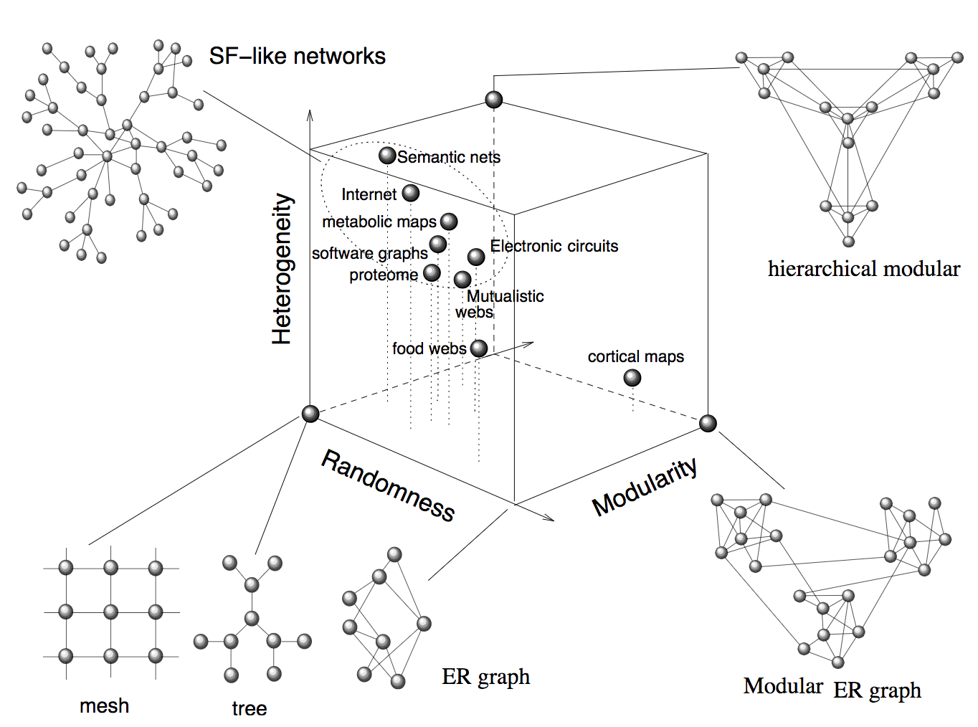
Where real network architectures fall relative to theoretical networks
Solé & Valverde (2004)

Slide 40
Implications of network architecture for disease
The architecture of a graph determines the severity of a perturbation to a node or edge
Can node/edge level features inform the potential for disease?

Slide 41
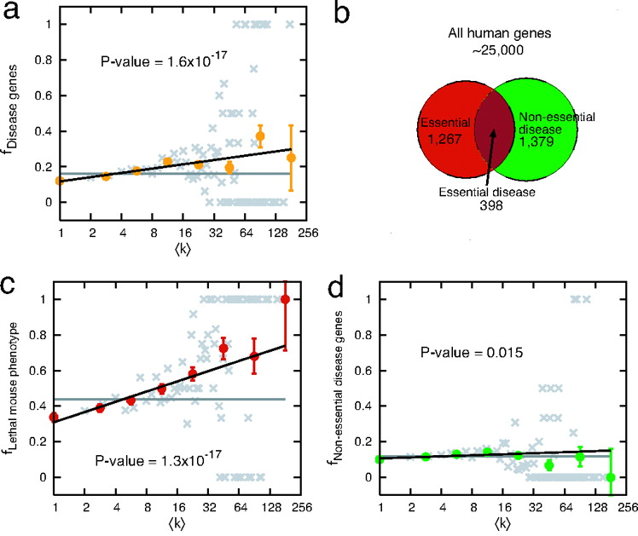
Degree of disease genes
High degree proteins more likely disease associated
Essential genes are much more likely to be hubs
Kwang-Il Goh et al. PNAS 2007;104:8685-8690
Notes:
High degree proteins show a tendency to be disease associated
But this is driven by the 22% of disease genes that are also essential genes
Essential genes are strongly biased towards hubs
When Essential genes are removed, there is no apparent bias towards hubs for disease genes
Gray – data binned on linear scale, color – data binned on log scale

Slide 42
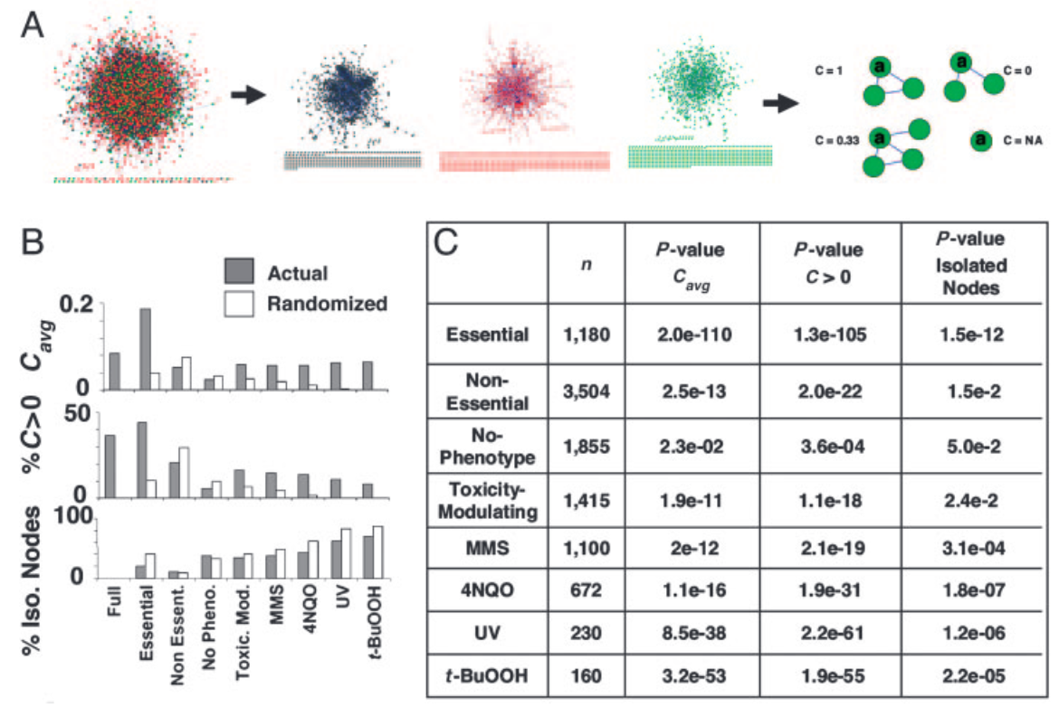
Edge density versus phenotype
Clustering Coefficient
Essential genes have higher C(v)
Actual
Randomized
0.2
C(V) avg
0
Full Essential
Non Essent.
No Pheno.
Toxic. Mod.
Said et al PNAS 2004
Notes:
Essential, toxicity-modulating, and no-phenotype classifications were based on results obtained by the S. Cerevisiae Gene deletion consortium

Slide 43
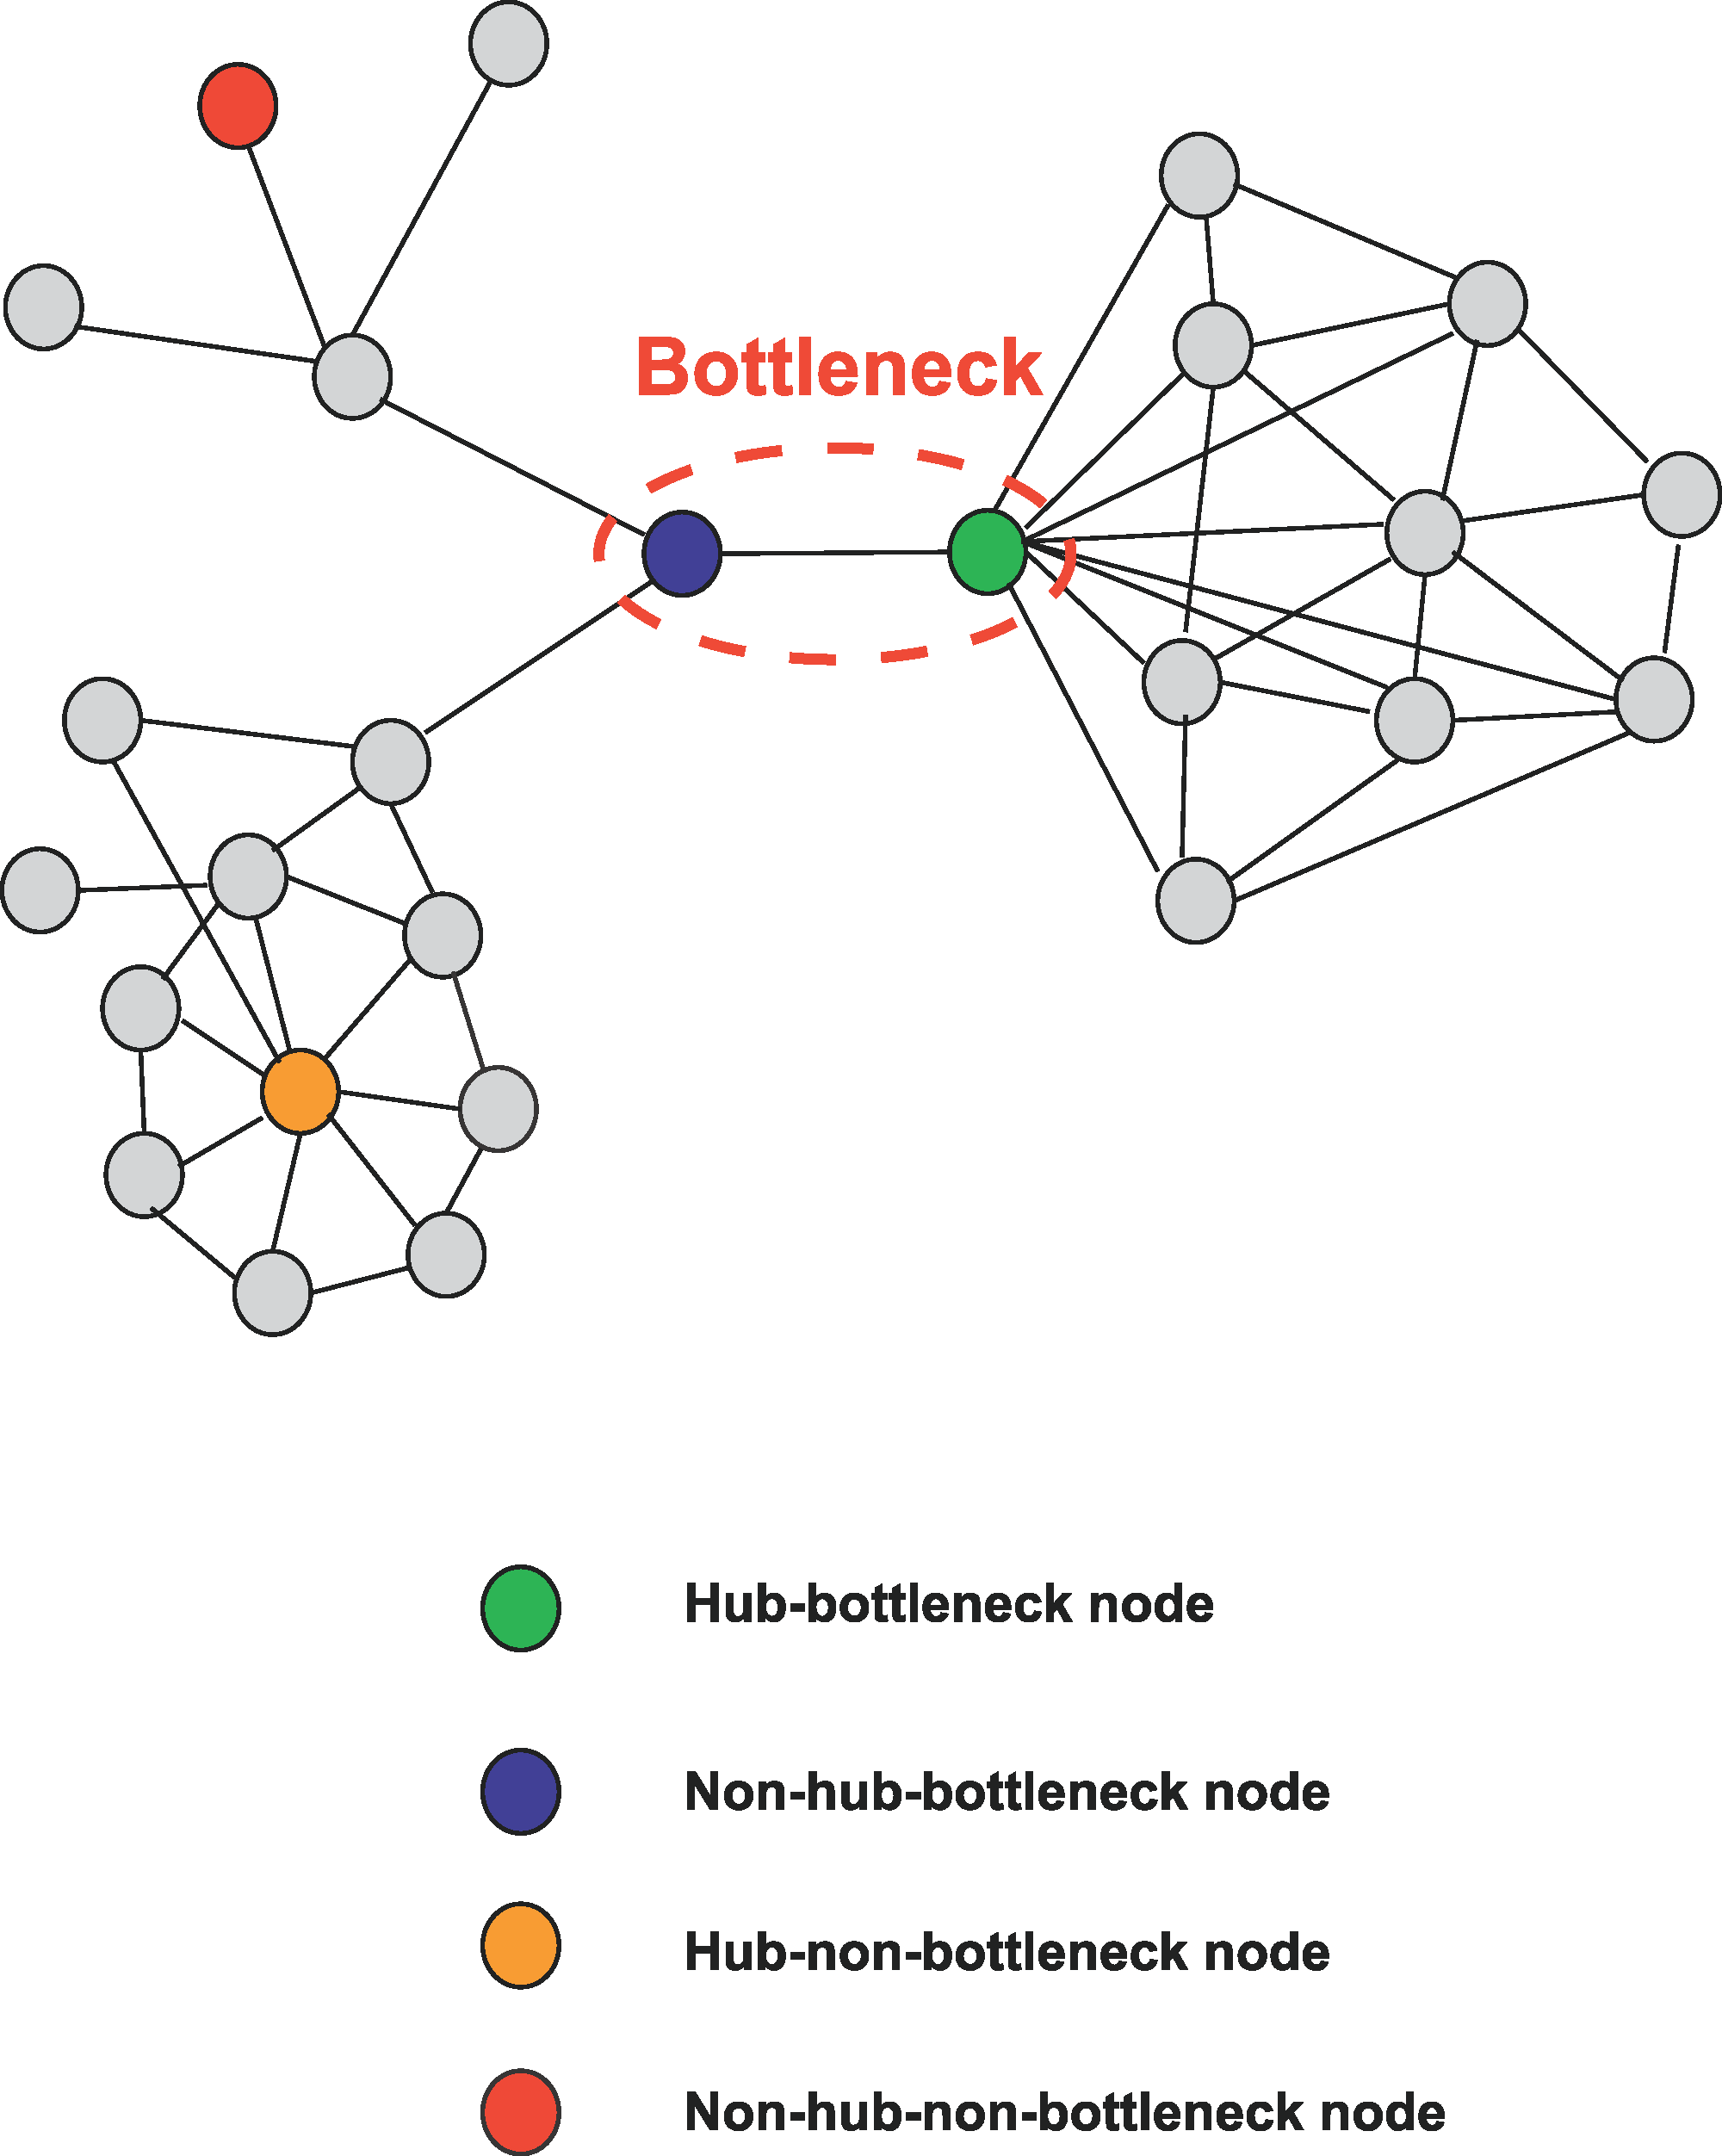
Topology versus information flow
Bottlenecks: nodes with high centrality
Can have low or high degree
Centrality-Lethality Hypothesis
The more central a gene/protein is, the more likely it is essential
Yu et al Plos Comp Bio 2007
Notes:
Small worldness + modularity results in bottle necks

Slide 44
Network centrality features
Degree: How many nodes can this node reach directly?
Betweenness: How likely is this node to be the most direct route between two nodes in the network?
Closeness: How fast can this node reach all nodes in the network?
Eigenvector: How well is this node connected to other well-connected nodes?
(bottleneck)
(central)
(connected to other hubs)
(hub)
Notes:
Old:
Degree: the number of interacting partners of a protein
Betweenness: are they in the shortest path of other nodes? (bottlenecks)
quantifies the number of times a node acts as a bridge along the shortest path between two other nodes
The betweenness centrality of a node reflects the number of shortest paths (geodesics) from all nodes to all others that pass through it
Closeness: the average length of the shortest path between the node and all other nodes in the graph
Eigenvector: a measure of the influence of a node in a network
quantifies each protein’s connectedness to high degree proteins (hubs)
In conclusion: we looked at some network centrality features that show how influential these nodes are in the network
It looks like candidate genes definitely have a similar profile to known drivers (especially TS) compared to rest
This also shows the premise of these candidate driver genes to perturb PPI networks

Slide 45
Node centrality measures
Degree centrality
normalized
Closeness centrality
Eigenvector centrality
normalized eigenvector of first eigenvalue of the adjacency matrix
Intuition: A nodes importance depends on the importance of its neighbors
Betweenness centrality

Slide 46
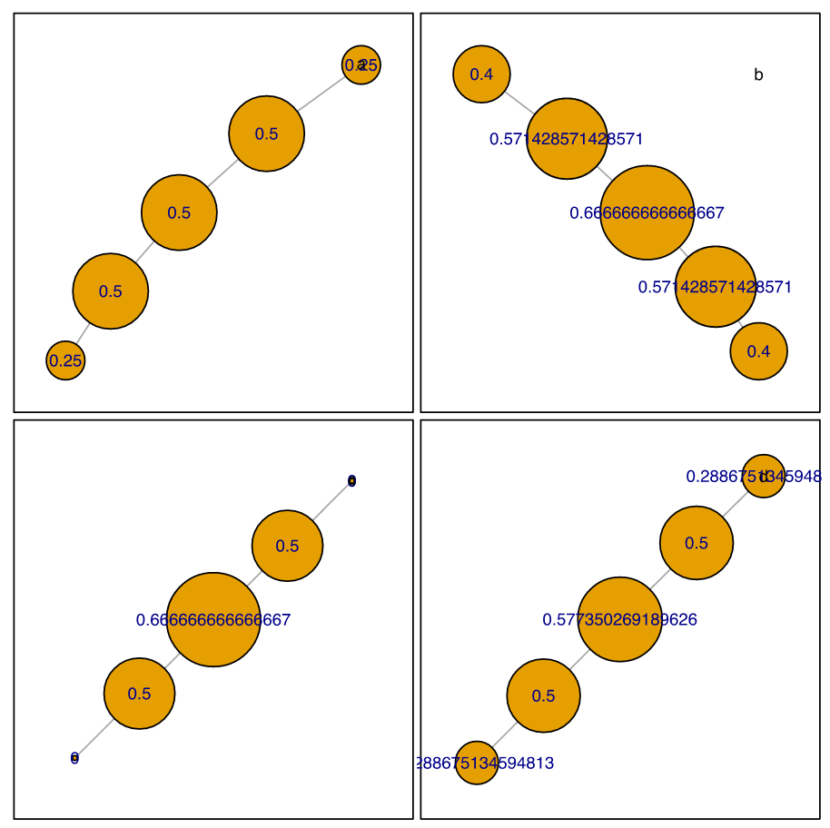
Node centrality measures
Different node weight distributions for the same graph
Degree
Closeness
Betweenness
Eigenvector

Slide 47
Topology versus information flow
Bottlenecks: nodes with high centrality
Can have low or high degree
Centrality-Lethality Hypothesis
The more central a gene/protein is, the more likely it is essential
Yu et al Plos Comp Bio 2007

Slide 48
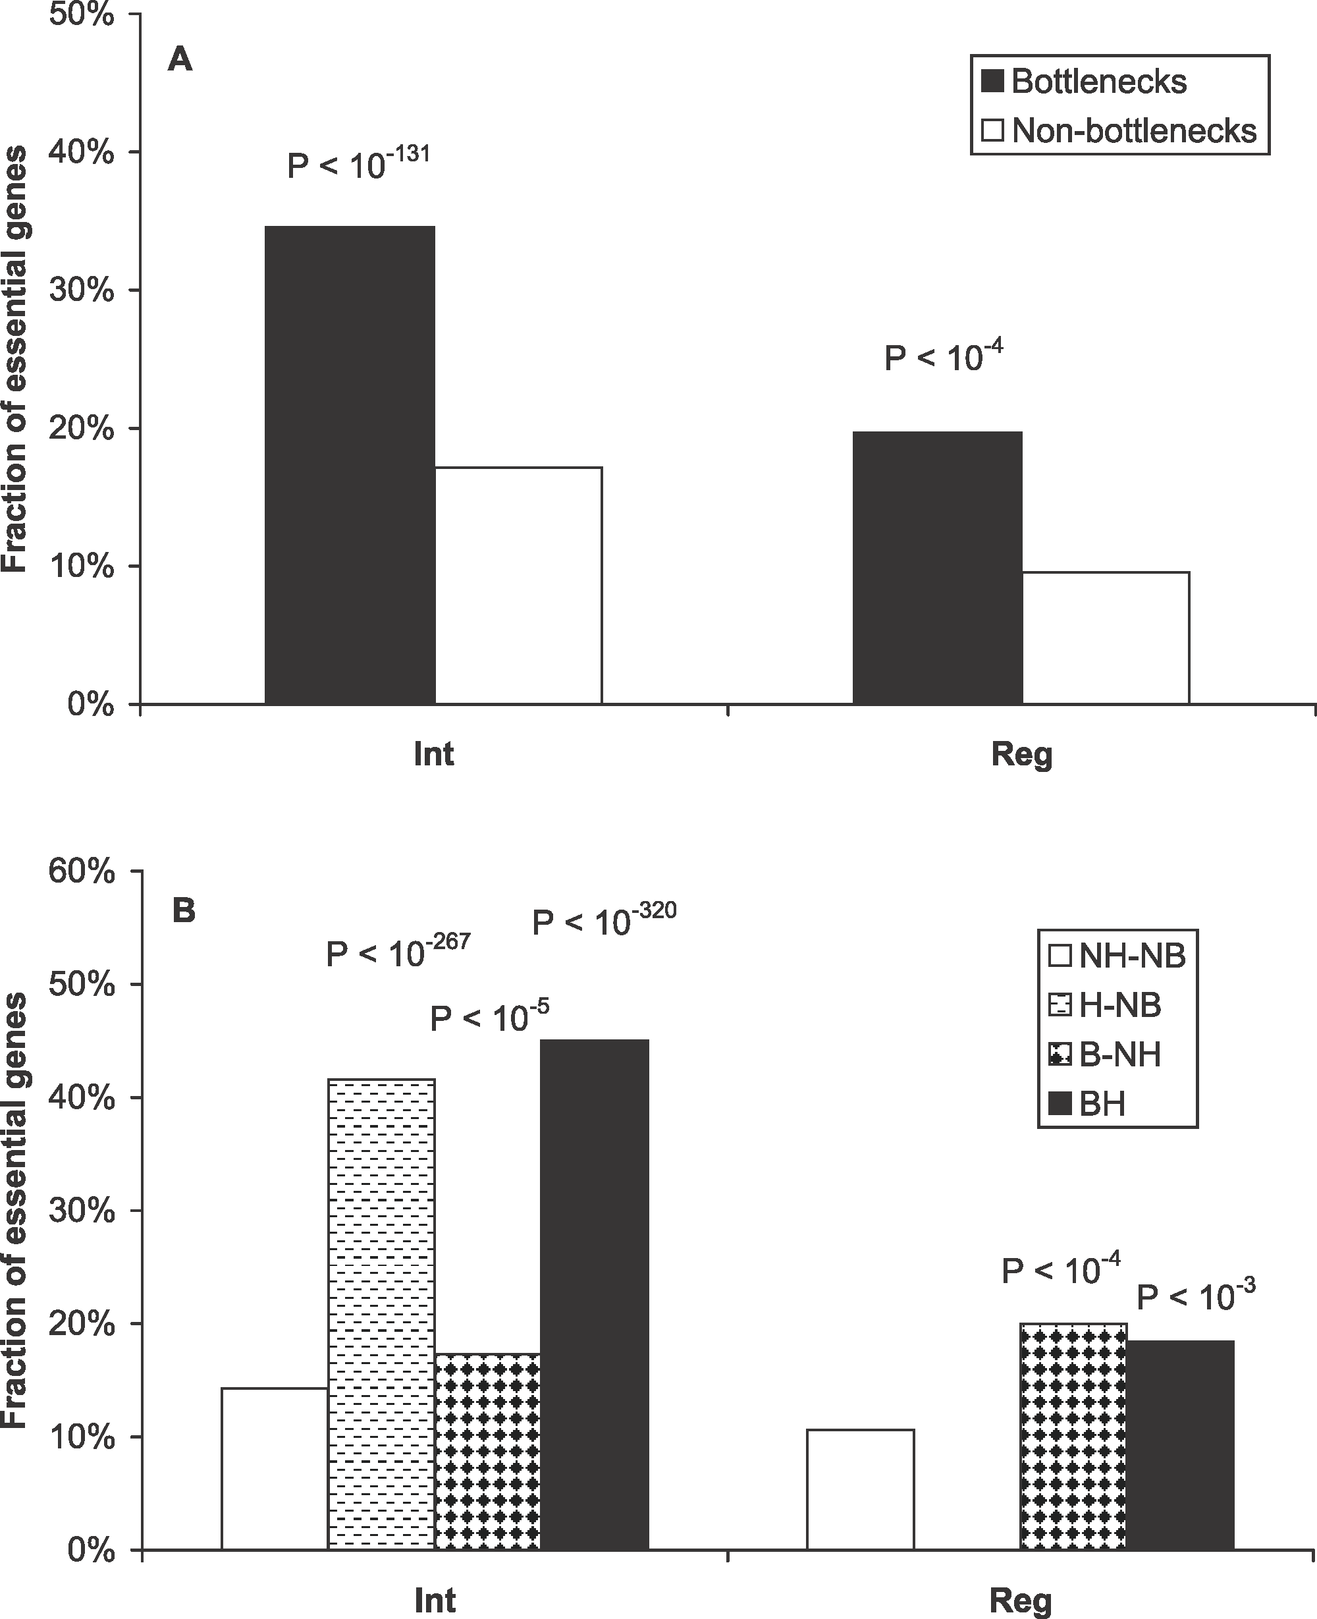
Node centrality in biology
Bottlenecks: nodes with high centrality
Can have low or high degree
Centrality-Lethality Hypothesis
The more central a gene/protein is, the more likely it is essential
Yu et al Plos Comp Bio 2007
Notes:
A) Bottlenecks tend to be essential genes in both interaction and regulatory networks. p-Values measure the statistical significance of the different essentialities between bottlenecks and nonbottlenecks.
(B) Essentiality of different categories of proteins. NH-NB, nonhub–nonbottlenecks; H-NB, hub–nonbottlenecks; B-NH, nonhub–bottlenecks; BH, hub–bottlenecks. p-Values measure the statistical significance of the different essentialities between different categories of proteins against nonhub–nonbottlenecks using cumulative binomial distributions

Slide 49
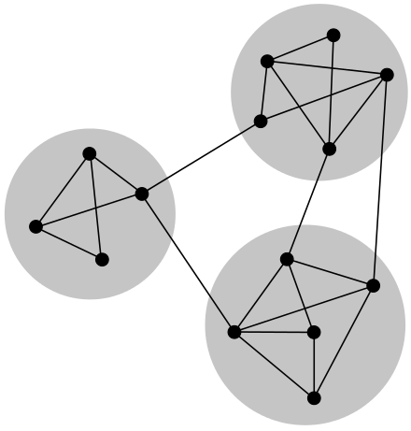
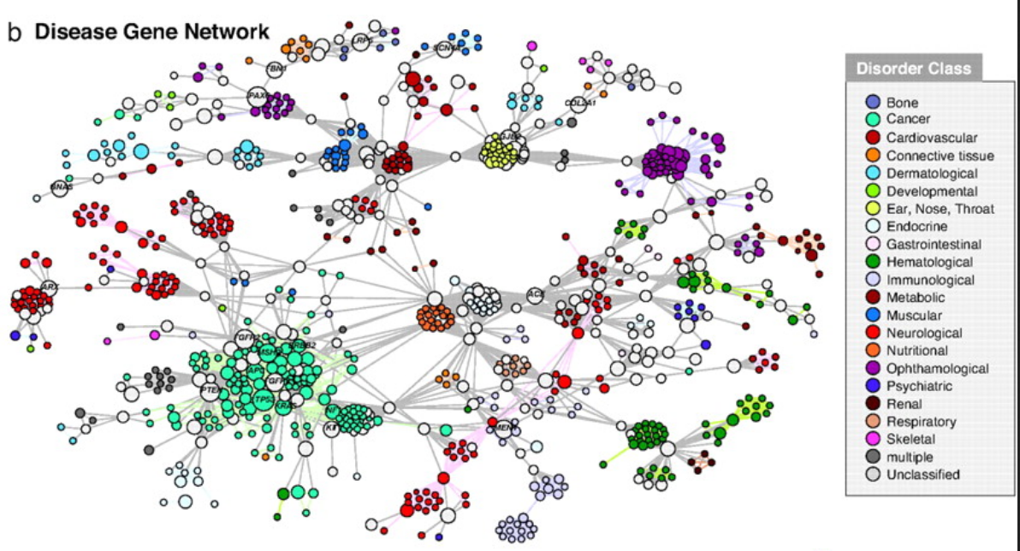
Modularity in Biological Networks
Groups of more highly connected nodes
Tend to be more functionally related
Guilt-by-association

Slide 50
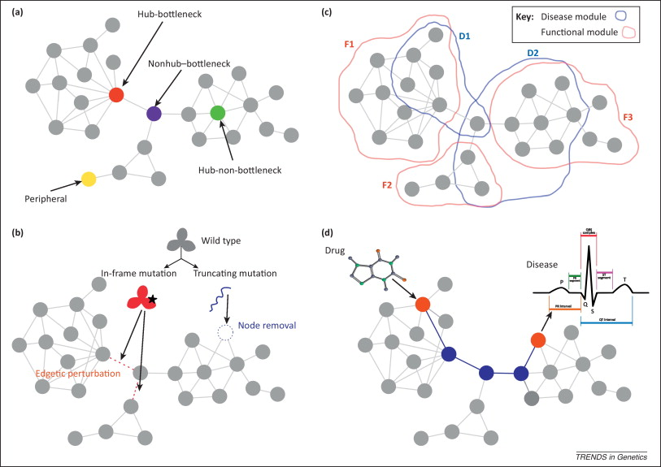
Network properties of human disease genes
Topology
Modularity
Perturbation
Gene X Environment
Furlong L. Human diseases through the lens of network biology Trends in Genetics 2013
Notes:
Different network attributes of disease genes are illustrated in a protein interaction network (PIN). (a) Nodes can be characterized by their role in the network, as peripheral, hubs, or bottlenecks. (b) The type of mutation of a protein (in-frame or truncating) leads to different perturbations in the PIN. Nonsense mutations, frame-shift mutations, and splice-site mutations lead to truncated proteins or completely destabilized proteins that can no longer maintain proper interactions with their protein partners. Such truncating mutations remove a node from the network and abolish all interactions. By contrast, subtle changes, such as single amino acid substitutions affecting binding sites or truncations that retain certain domains of the protein, may produce partially functional proteins that affect only a subset of their interaction partners. These in-frame mutations are referred to as edge-specific genetic, or edgetic, perturbations. (c) Different regions of a network can be identified according to the involvement of the nodes in common biological processes [functional (F) modules] or the same disorder [disease (D) modules]. Note that there is not a perfect overlap between functional and disease modules. In addition, different disease modules may overlap at least in part due to shared genetic determinants. (d) The interplay between environmental factors and genetic variation can be studied with network analysis. For example, the relation between the target of a drug and the protein associated with an adverse effect is modeled by calculating a distance measure in a PIN (edges highlighted in blue).
Kotlyar et al. (2012) found that the centrality of genes regulated by a drug target was correlated with the toxicity of the drug.

Slide 51
Exercise: Basic network analysis with iGraph
Jupyter Notebook: Exercise 2

Slide 52
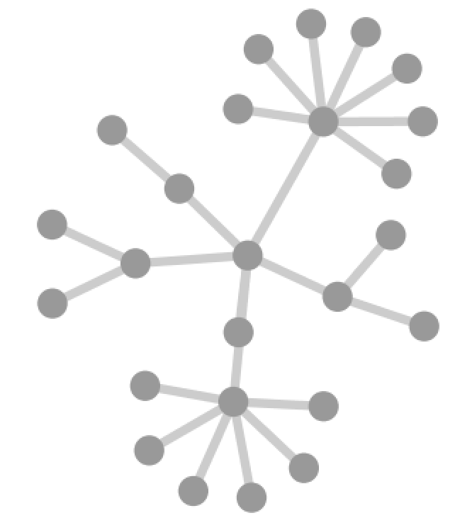
Challenges for Network Inference
Network Type?
Protein interactions
Regulatory interactions
Genetic interactions
Metabolic interactions
PTMs …
Notes:
Network analysis very exciting but it does face a few challenges
First need to decide what type of network to use for analysis
Physical interactions, functional interactions, etc …

Slide 53
Challenges for Network Inference
False positive
edges
Missing nodes
and edges
X
X
Study bias
Notes:
Information about molecular interactions within the cell are incomplete
There may be false positive information
Study bias such that highly-studied genes have more connections

Slide 54
Challenges for Network Inference
Edge direction
Activation
Inhibition
Notes:
Information about interactions also incomplete
Directional information important for reasoning about cause-effect relationships or signal transduction

Slide 55
Challenges for Network Inference
Tissue specific expression
Ubiquitous
Tissue A
Tissue B
?
Cancer
Notes:
Context is important – some genes are expressed ubiquitously while some are tissue specific
Cellular environment e.g. drug exposure or DNA damage can initiate cellular responses that alter expression paterns
How to analyze cells with aberrant expression patterns in disease state

Slide 56
Challenges for Network Inference
X
Epistasis
XX
XX
Negative
X
X
Positive
Notes:
Mutations occur on a genetic background
Interactions are often not additive
Mutations in same pathway versus parallel pathways mediating the same behavior

Slide 57
Challenges for Network Inference
X
X
Integration of data types
Mutation
Expression
PTM
X
Notes:
Multiple molecular measurement technologies often applied simultaneously
Although networks are a good framework or integration, it’s not trivial to integrate this information

Slide 58
Challenges for Network Inference
False positive
edges
Missing nodes
and edges
Tissue specific expression
Ubiquitous
X
Tissue A
X
Tissue B
?
Cancer
Study bias
Edge direction
Activation
Inhibition
X
Epistasis
Integration of data types
Mutation
Expression
PTM
XX
XX
Negative
X
X
X
Positive
Network Type?
Protein interactions
Regulatory interactions
Genetic interactions
Metabolic interactions
PTMs …
Notes:
Issues considered so far all at once

Slide 59
Challenges for Network Inference
False positive
edges
Missing nodes
and edges
Tissue specific expression
Ubiquitous
X
Tissue A
X
Tissue B
?
Cancer
Dynamic response to environmental cues
Compensatory response to mutations
Nodes often represent a population of molecules
Non-coding regions of the genome
…
Study bias
Edge direction
Activation
Inhibition
X
Epistasis
Integration of data types
Mutation
Expression
PTM
XX
XX
Negative
X
X
X
Positive
Network Type?
Protein interactions
Regulatory interactions
Genetic interactions
Metabolic interactions
PTMs …
Notes:
Other important considerations
Cells are dynamic, cause and effect relationships may be difficult to disentangle
Important to keep in mind that each node represents a population of molecules and heterozygous vs homozygous events may have distinct effects
Models need to incorporate ncRNAs and regulatory regions of the genome
Despite all these challenges, many interesting network-based strategies have been developed for mining useful information from large scale tumor data

Slide 60
Managing uncertainty in networks
Take a probabilistic approach: Incorporate information about the confidence of measurements on nodes or edges
Design benchmarks to determine the extent to which a network recovers expected biology
Design simulations to determine sensitivity to parameters
Try to validate/establish reproducibility by using independent datasets

Slide 61
Exercise: Load a network in Cytoscape
Cytoscape
Example with software
http://cytoscape-publications.tumblr.com/

Slide 62
Conclusions (Day 1)
Properties of biological networks can lead to new insights about the function/evolution of biological systems
Need to carefully consider what you can and can’t infer and given the limitations of the data
Networks can be created from virtually any type of data

Slide 63
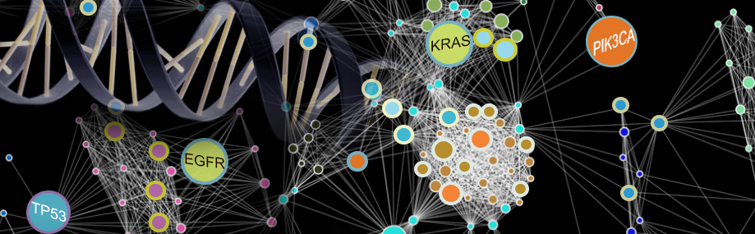
Thank you!

Slide 64
Contact Information
Questions / comments / suggestions
hkcarter@ucsd.edu

